Slide 1
Use of Propaganda During World War I and Beyond

Slide 2
Propaganda
Something designed to influence our opinions, emotions, attitudes and behavior to persuade us to believe in something or to do something
can be a poster, ad, song, movie, etc.

Slide 3
Goals of Propaganda Posters
Recruitment of soldiers: Posters aimed at recruitment attempted to get men to join the army and fight for their country.
Conservation of goods: These posters encouraged people at home to conserve goods so that they could be used by soldiers in the war.
Purchasing of war bonds: These posters advocated the purchase of war bonds, which would help the government fund the war.
Support for the war at home: These posters encouraged people not in the army to become involved in the war at home by joining organizations or working in industries related to the war effort.

Slide 4
Propaganda Techniques
Fear
Name Calling
Glittering Generality
Bandwagon
Plain Folks Appeal
Testimonial

Slide 5
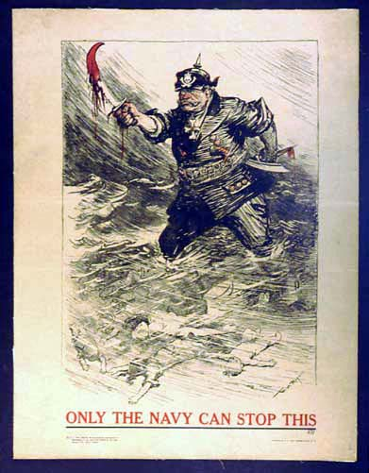
Propaganda Techniques
Fear

Slide 6
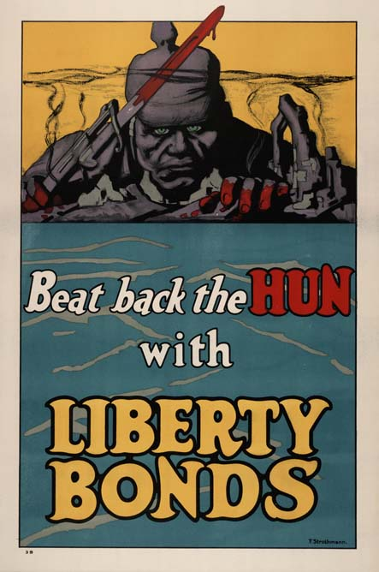
Propaganda Techniques
2. Name Calling
(negative names or
adjectives)

Slide 7
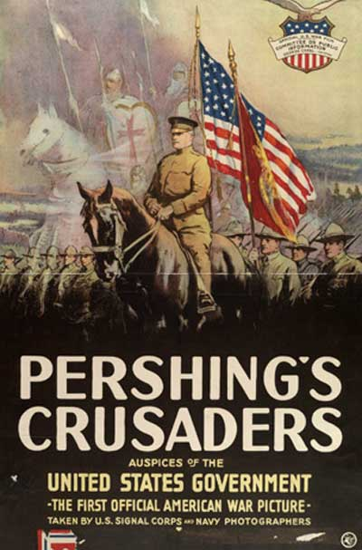
Propaganda Techniques
3. Glittering Generality
(Good adjectives / names)

Slide 8
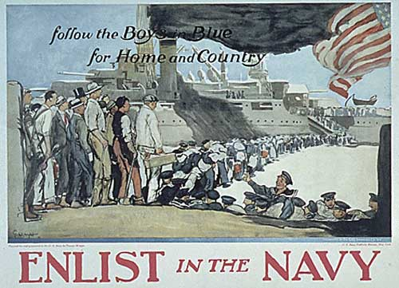
Propaganda Techniques
4. Bandwagon
(everyone’s doing it)

Slide 9

Propaganda Techniques
5. Plain Folks Appeal
( “of the people”)

Slide 10
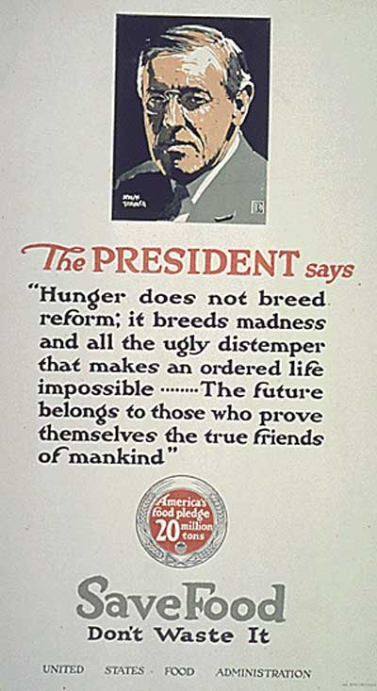
Propaganda Techniques
6. Testimonial
(famous endorsement)

Slide 11
Propaganda Includes:
A goal for the viewer
A technique
Images to capture the viewer
Words in the form of slogan

Slide 12
Why the need for increased U.S. propaganda during WWI?
President Wilson initially wanted to keep U.S. neutral and avoid the war abroad.
U.S. had a large immigrant population from Europe.
  17 million out of 100 million Americans had been born outside of the U.S.
There were strong feeling of support for the Central Powers from the German-American and Irish-American immigrants.

Slide 13
Why the need for increased propaganda during WWI?
When the U.S. finally decided to enter the war in 1917 there was major concern about the “lack of public unity” about the war.
This concern led to the creation of the Committee of Public Information (CPI).
The CPI’s goal was to “promote the war domestically while publicizing American war aims abroad.”
During WWI, the U.S. published more propaganda posters than any other single nation.

Slide 14


Slide 15
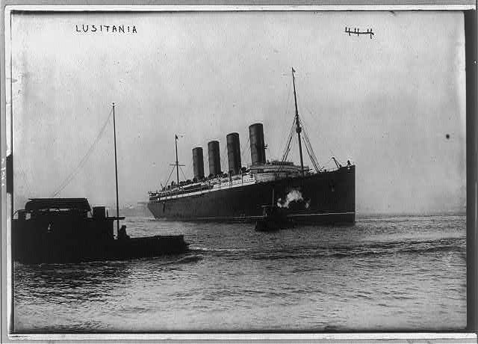
The Lusitania

Slide 16
British response to sinking of Lusitania
Deemed the incident an “Act of Piracy.”
Increased its use of propaganda to include images of the Lusitania sinking to further influence the hearts and minds of the American public.

Slide 17

Example of British Propaganda

Slide 18
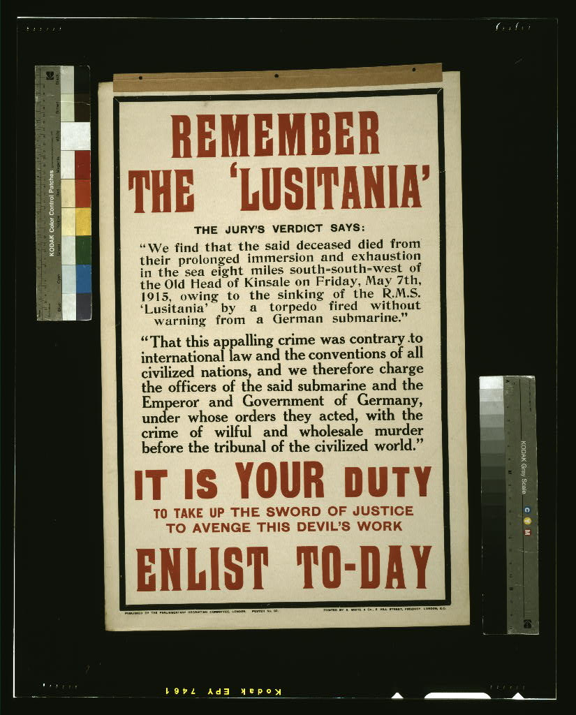
Example of British Propaganda

Slide 19
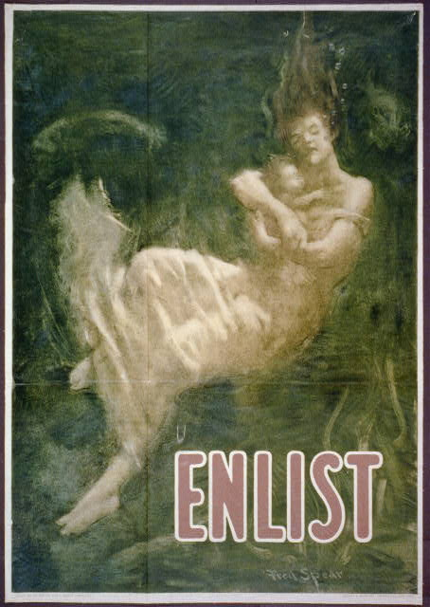
Example of U.S. Propaganda

Slide 20
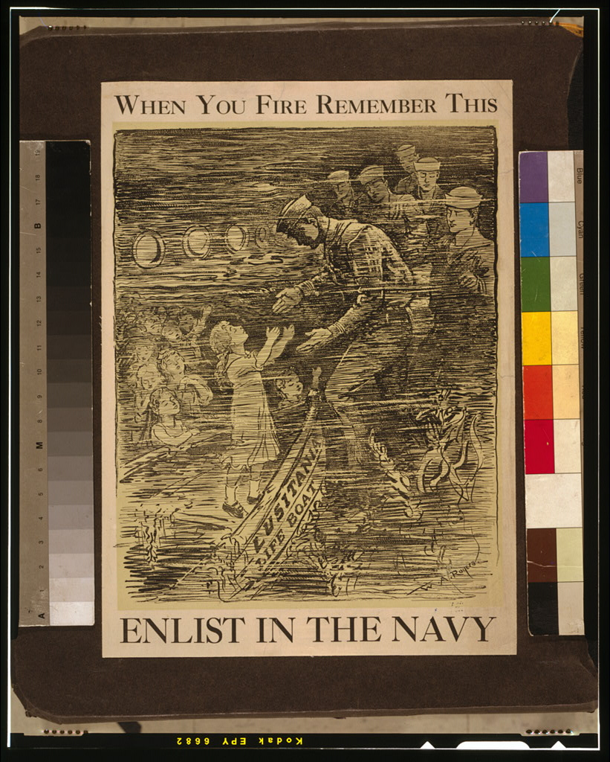
Example of U.S. Propaganda

Slide 21
How did Germany respond to Lusitania disaster?
The German government defended itself saying the ship had been armed with guns and had “large quantities of war material in her cargo.”

Slide 22
Was German Propaganda effective in the United States?
Most of their propaganda was anti-Russian, which did appeal to many Americans.
After the Lusitania disaster the German government’s response angered many Americans who viewed the sinking of the ship as an act of terror.
This event continued to pave the way for America’s eventual involvement in WWI.

Slide 23

Example of German Propaganda

Slide 24
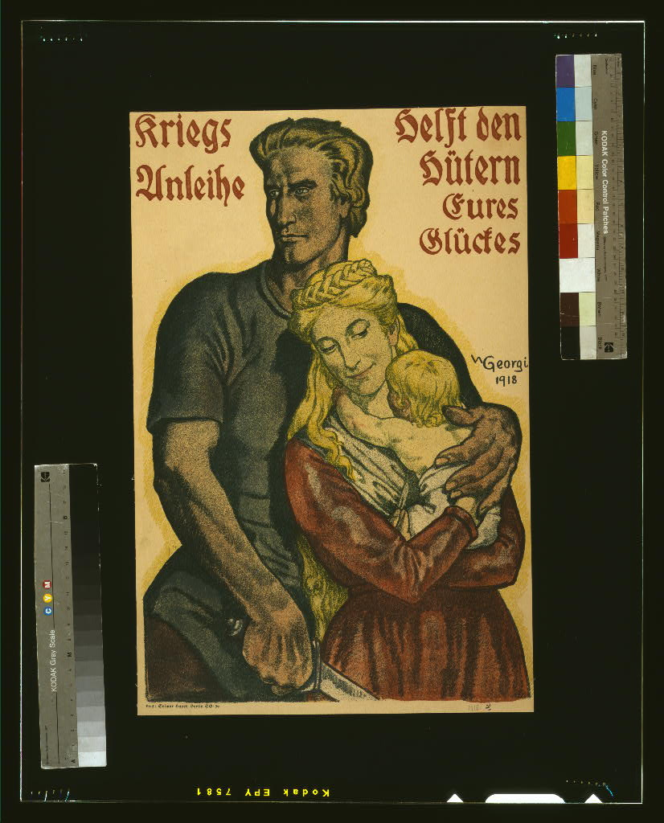
Example of German Propaganda

Slide 25
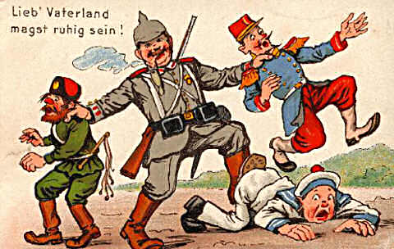
Example of German Propaganda

Slide 26
How did Great Britain use propaganda to influence Americans?
Cut the transatlantic telegraph cable from Europe to the United States, making Americans dependent upon the British for news of the war.
Launched a large scale covert operation to reach out to America’s opinion leaders, libraries and newspapers, and provide them with information about the war from the British perspective.
Told stories of German atrocities towards Belgian citizens to gain American sympathy.

Slide 27
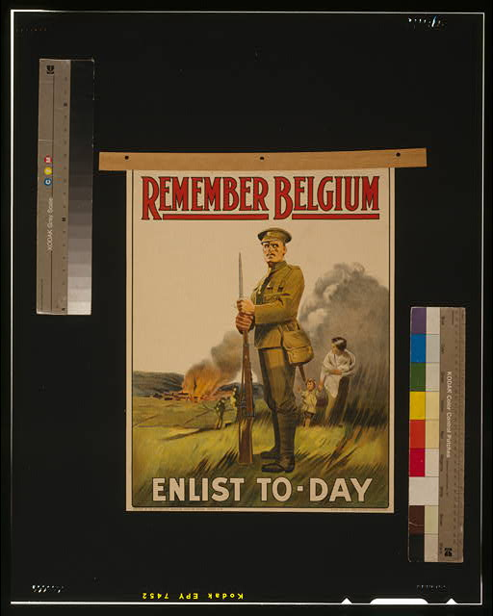

Slide 28
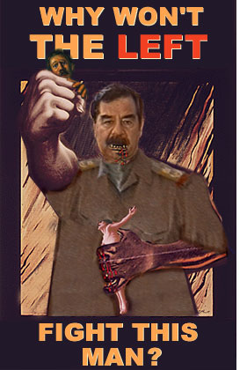


Slide 29
Propaganda in the 21st century
The Government no longer relies on mass producing posters to promote a certain agenda; it depends on the relationship between the media and the military.

Slide 30
Propaganda in the 21st Century
Miren Guiterrez, editor-in-chief of Inter Press Service lists the following strategies as examples of how propaganda is being used today:
Incompleteness
Inaccuracy
Driving the agenda
Milking the story
Exploiting that we want to believe the best of ourselves
Perception management
Reinforcing existing attitudes
Simple repetitious and emotional phrases (i.e., war on terror, axis of evil, weapons of mass destruction, shock and awe, war of liberation, etc).

Slide 31
The following web site was used in the creation of this presentation:
www.wayzata.k12.mn.us/wms/images/stories/propaganda.ppt

